Slide 1
Cmpe 226 - Database Project Hospital Management & Alert System
Team Decoders-
-Chandra Shekhar
-Devashish Badlani
-Simranjeet Singh
-Harshada Mone

Slide 2
Application Description
Hospital Management Application with various features:
Sign up and Login for Patient and Employee
Search Employee based on department, employee geo- location
Search and display all patients of a doctor
Calculate total bill of a patient based on room charges, treatment charges, visit charges and doctor charges.
Update billing information when a doctor visits a patient.
Send email alert to main doctor if certain reading is greater than a threshold value
Display all the analytical information in form of graphs and chart.
Implemented ORM.

Slide 3
Database and Dataset
We have two types of databases
Operational Database(mysql)
Analytical Database(mysql)
We have used two health data sets
XML based
JSON based stored in mongoDB (Multiple sources)

Slide 4
Data Sources
Data source for Treatment and Description of treatment from Centers for Medicare & Medicaid Services. https://www.cms.gov
Patient and Employee details generated using mockaroo.com (FirstName, LastName, Email, StreetAddress, Zipcode, City, State).
Catalog.data.gov
Data.cms.gov
Wrote mysql procedure to cleanse the data and populate certain tables .
Wrote scripts to do ETL

Slide 5
Data Synchronization - Operational to Analytical Tables
Basic strategy is to select, join, and aggregate data from our operational tables.
Then, we insert this data into a analytical table
Wrote mysql event that calls various procedures after certain period of time to load data from operational tables to analytical tables and fact tables.
Use unique constraints on analytical tables to enforce row uniqueness and identity (removed inconsistent data).

Slide 6
Data Synchronization - Operational to Analytical Tables
DELIMITER ; BEGIN
DECLARE done INT DEFAULT FALSE;
DECLARE pid, eid, charge,tid INT(11);
DECLARE nresult CURSOR FOR
SELECT v.Patient_ID , v.Employee_ID ,t.Time_ID, v.Visit_charge FROM finalproject1.Time t, finalproject1.Visit1 v WHERE t.year = Year(v.time_stamp) and t.month = Month(v.time_stamp) and t.Day_of_year = DayofMonth(v.time_stamp) ;
DECLARE CONTINUE HANDLER FOR NOT FOUND SET done = TRUE;
OPEN nresult;
read_loop: LOOP
FETCH nresult INTO pid, eid , tid, charge ;
IF done THEN
LEAVE read_loop;
END IF;
insert into finalproject1.treatment_fact Values ( eid, pid , tid, charge);
END LOOP;
CLOSE nresult;
END
DELIMITER |
CREATE EVENT myevent
ON SCHEDULE EVERY 1 WEEK STARTS '2016-11-30 03:00:00'
DO
BEGIN
CALL populate_analyticalTables();
CALL populate_recordFactTable();
CALL populate_treatmentFactTable();
CALL populate_stayFactTable();
END |

Slide 7
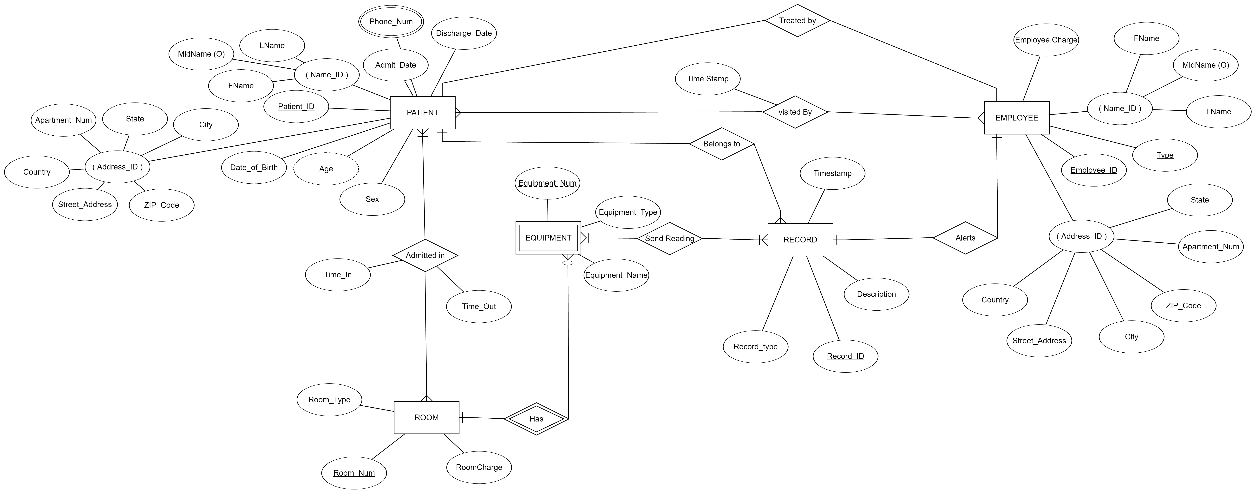
ER Diagram

Slide 8
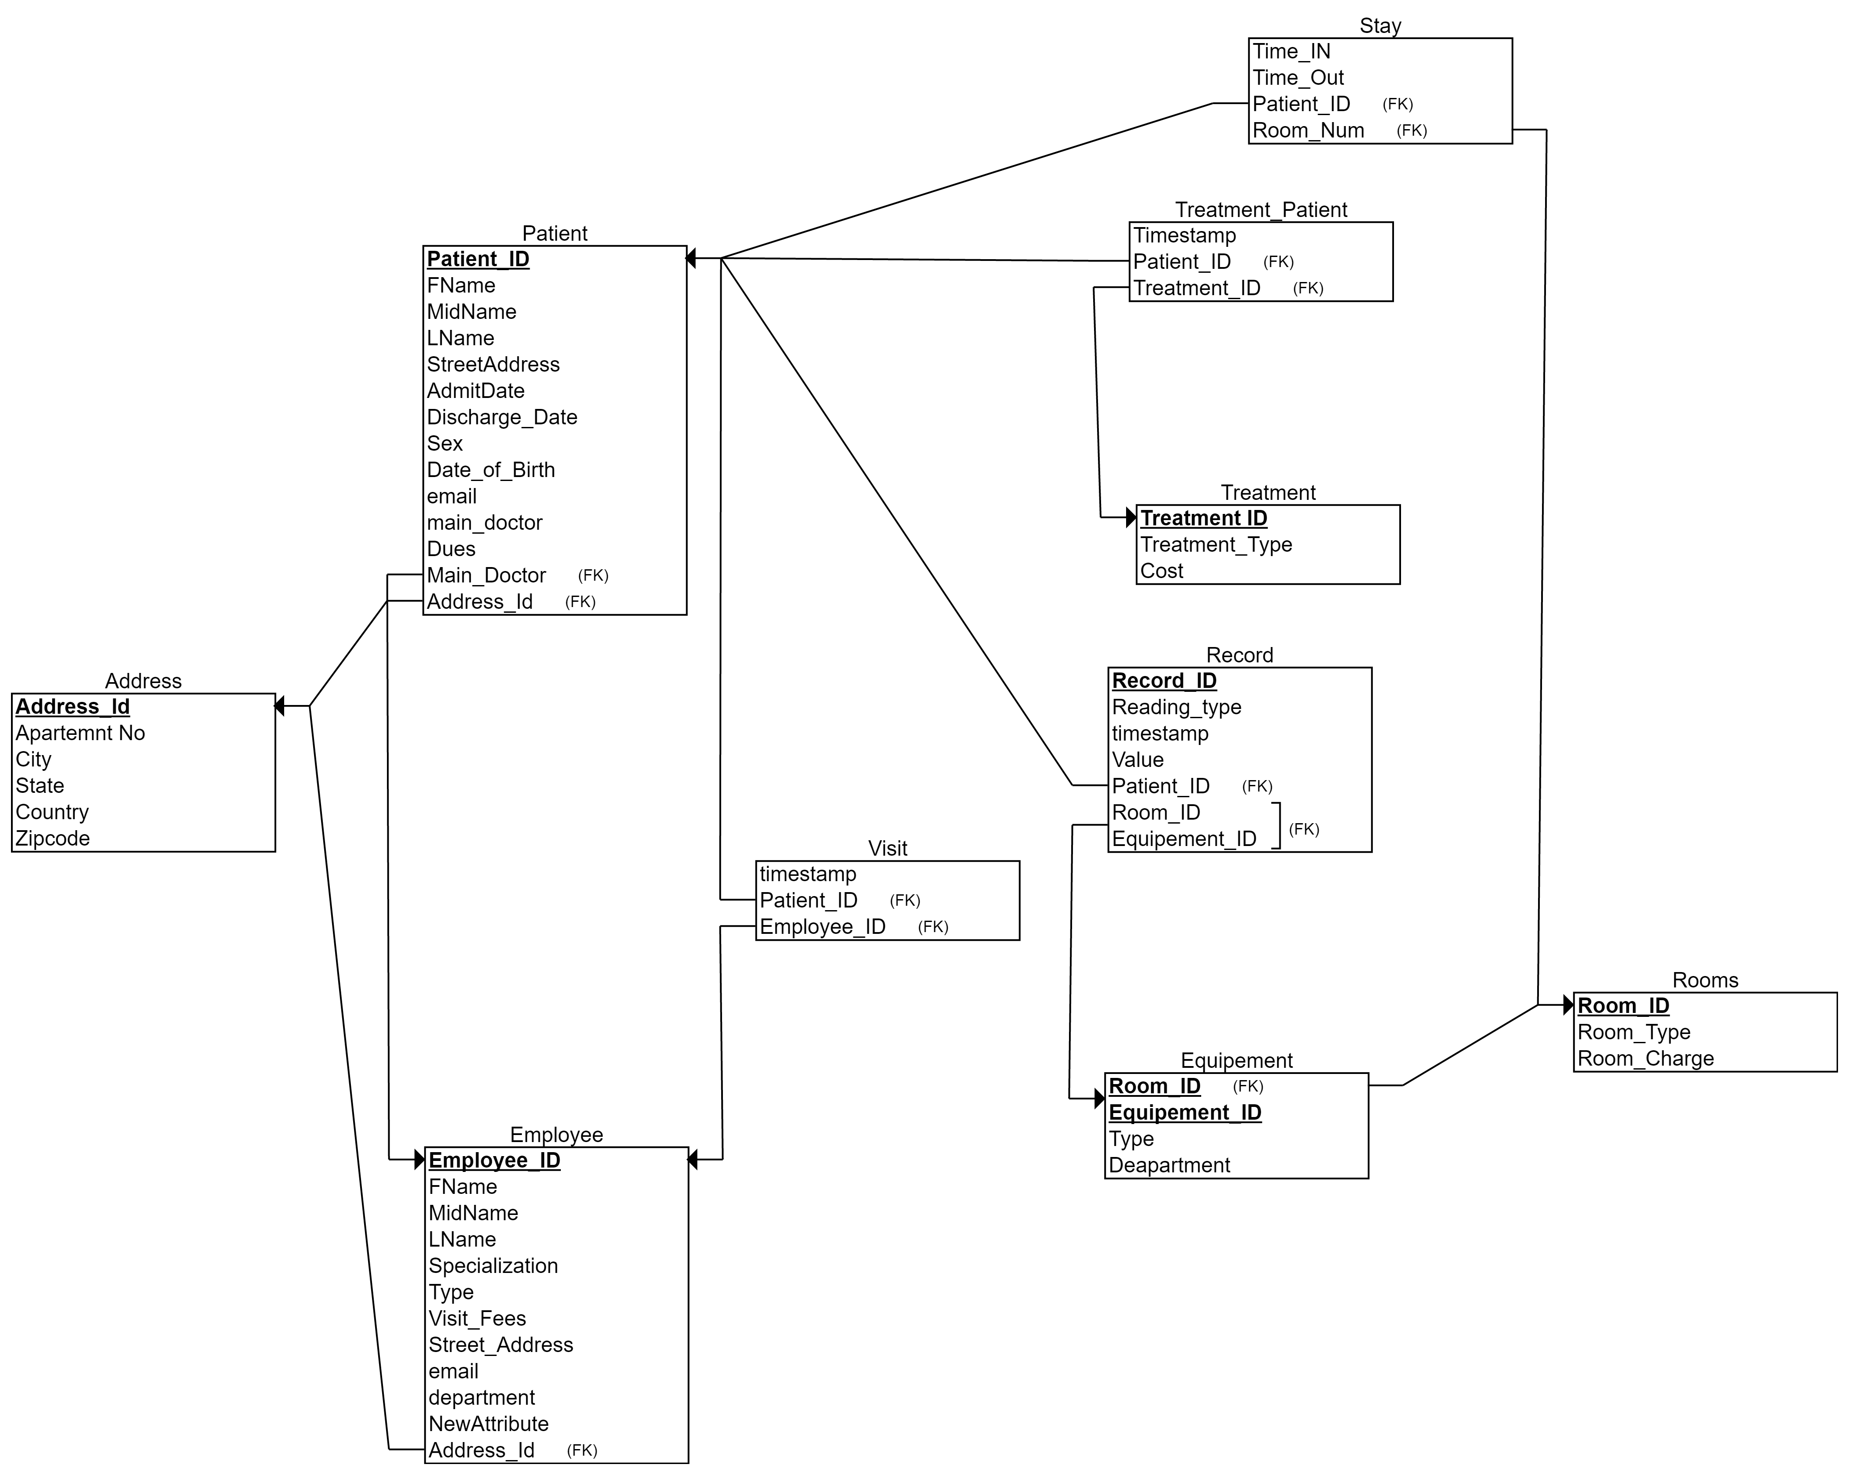
Relational Schema

Slide 9
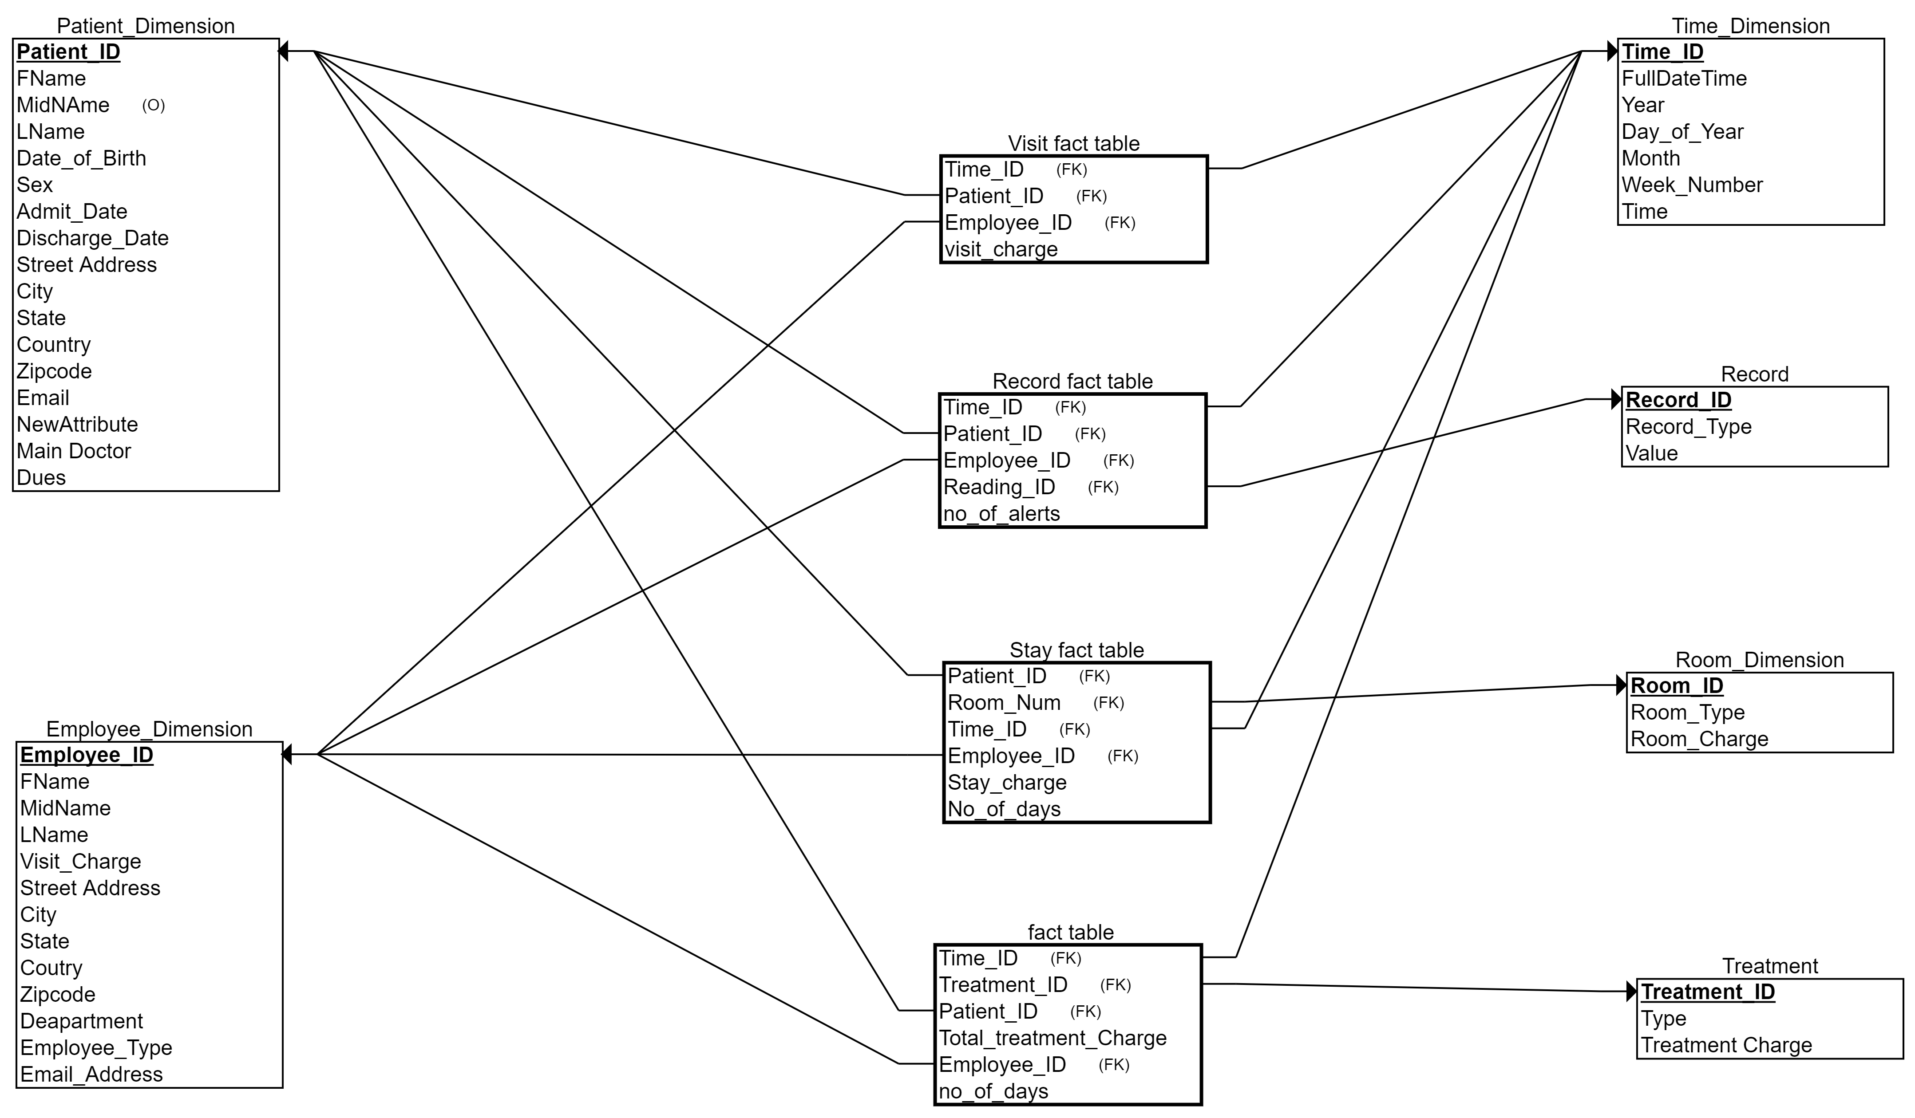
Star Schema

Slide 10
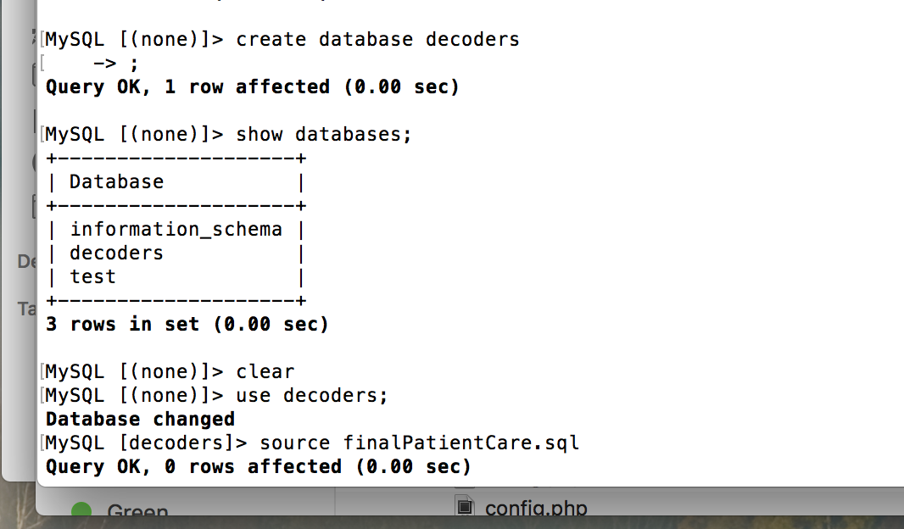
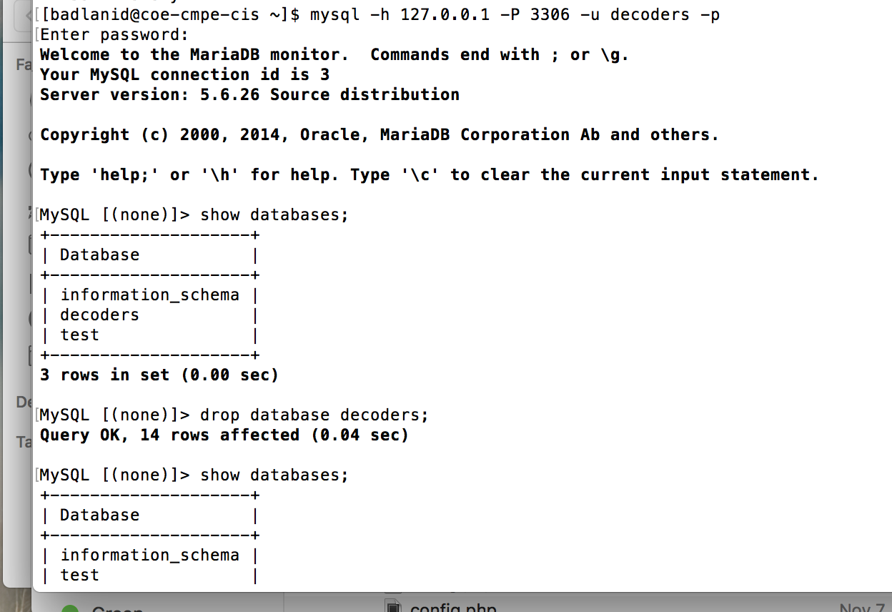
Data Ported to CIS Server

Slide 11
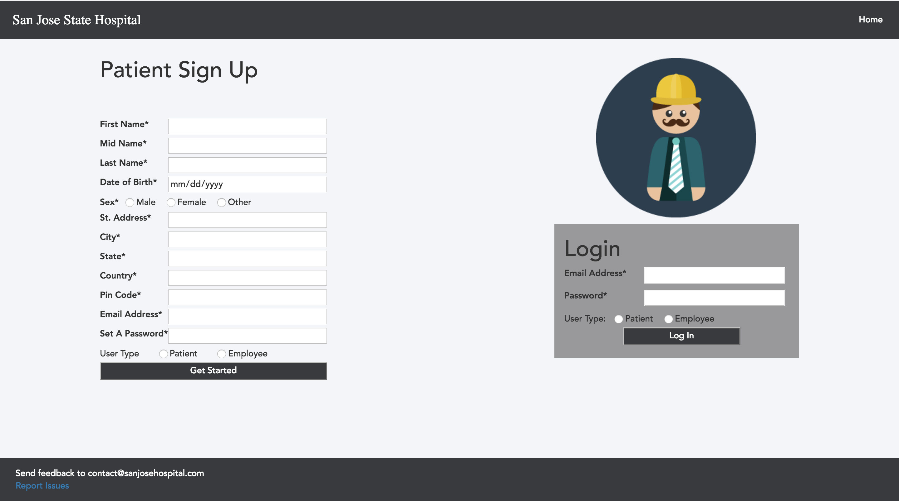
Operational Queries
Patient and Employee Registration-
New Patient and Employee SignUp by entering all the patient details and Employee details which gets inserted into patient and employee table respectively.

Slide 12
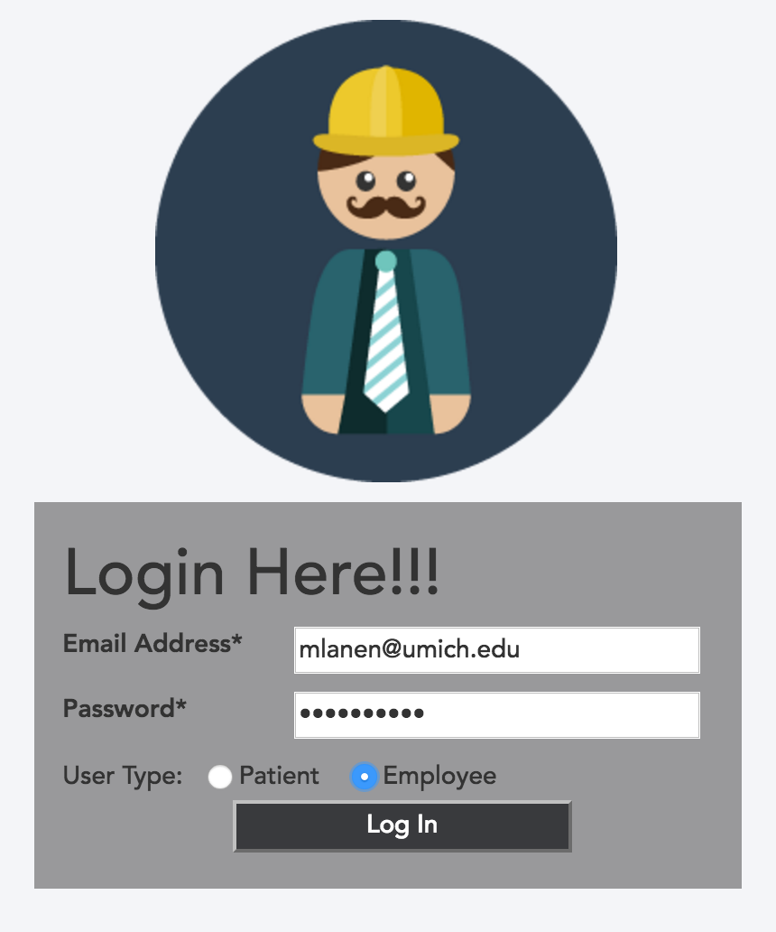
Operational Queries
Login-
When the user submits the login form, we query the patient and employee table based on user type to retrieve their record, so we can verify that their password matches the hashed value stored in database an related page appear dynamically.

Slide 13
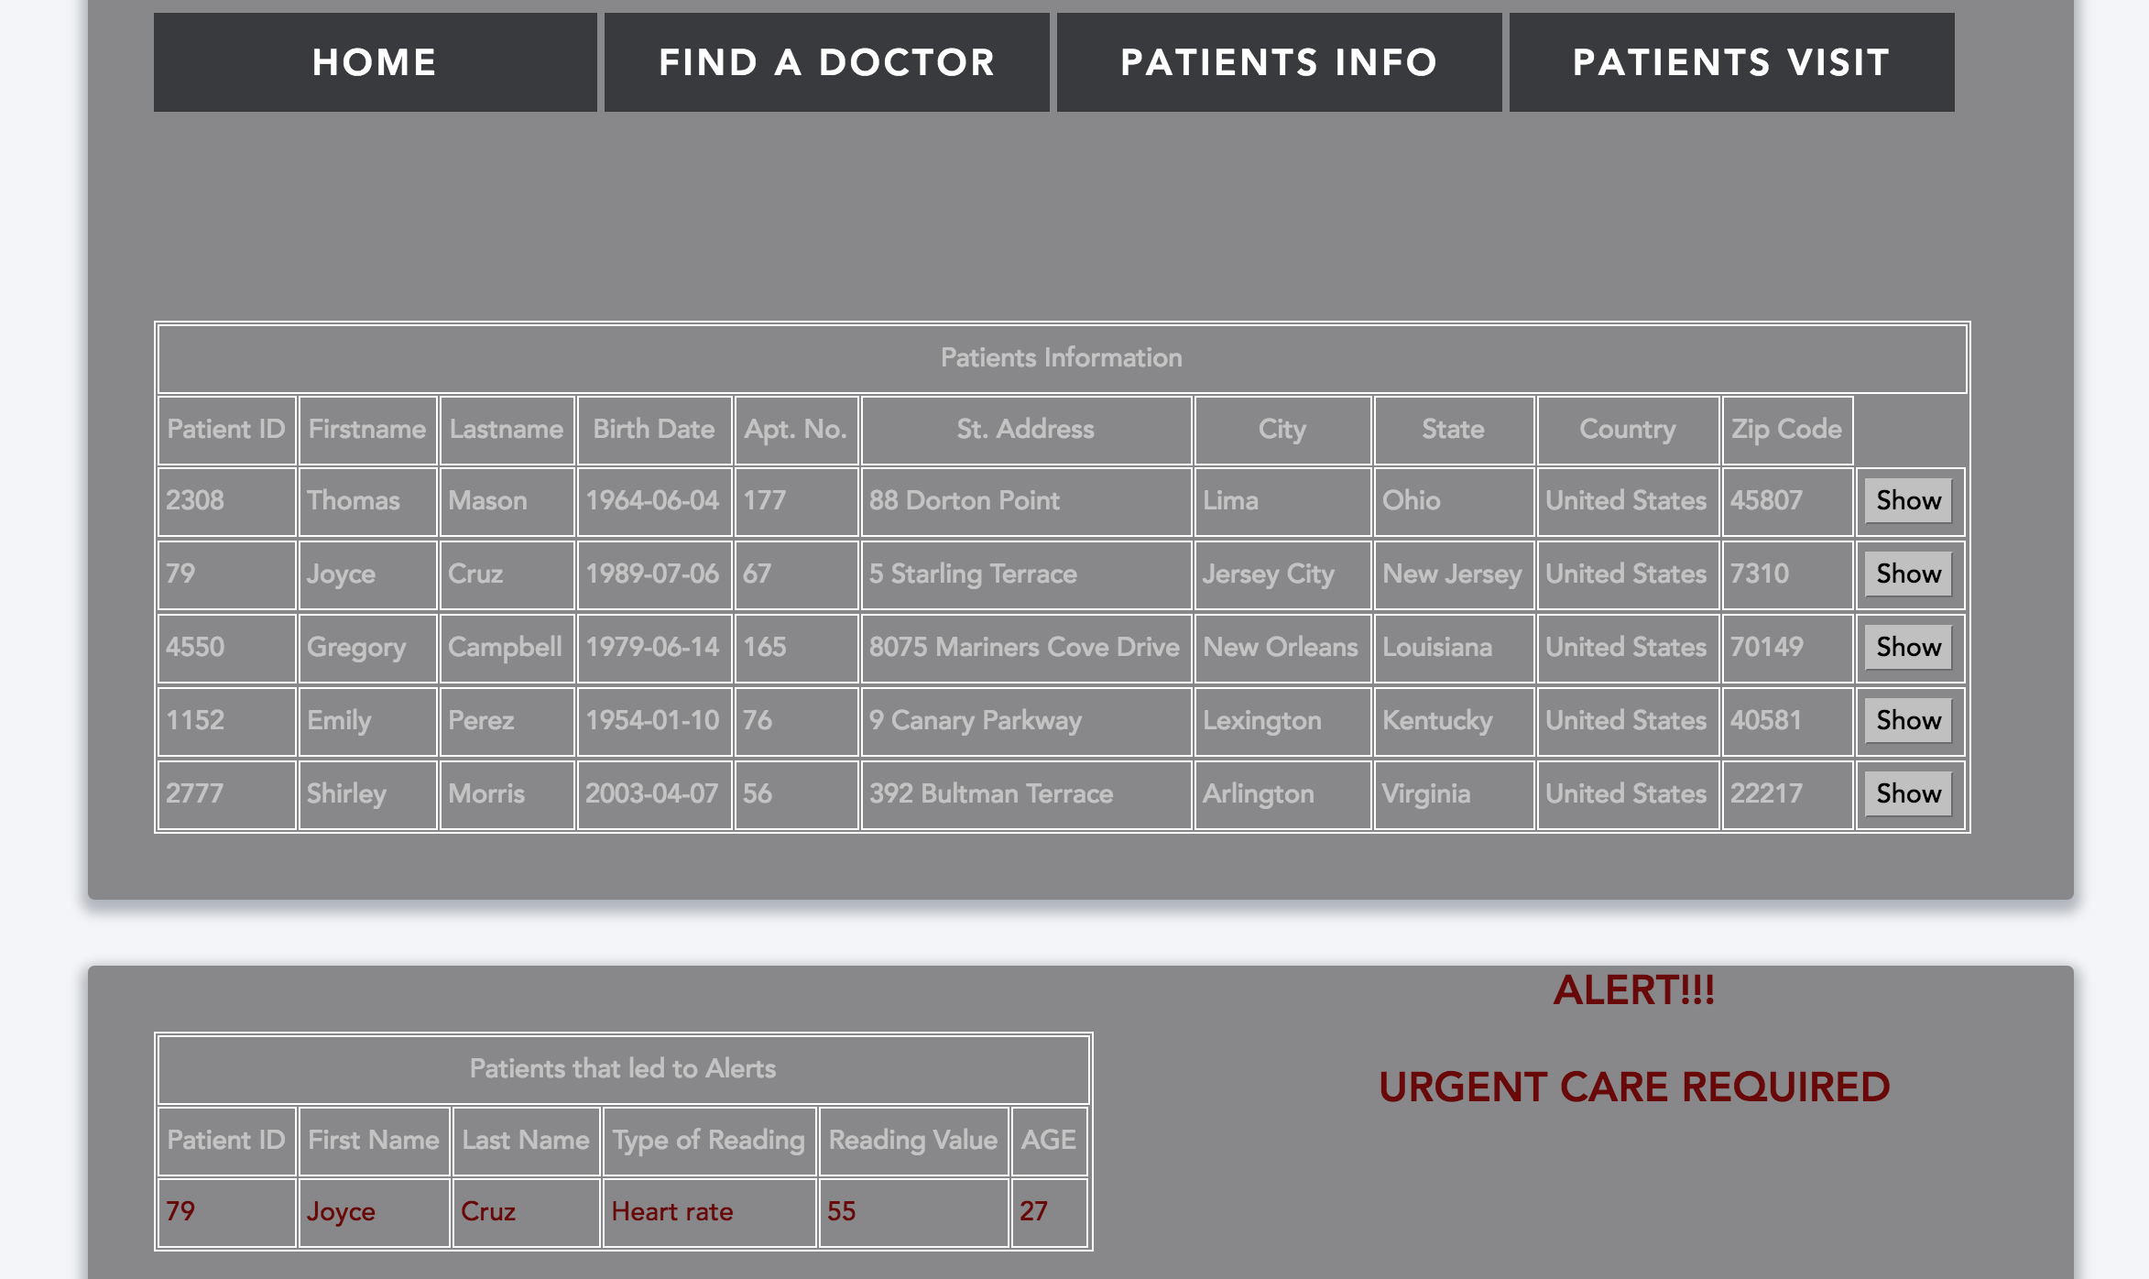
Operational Queries
Search and display all patients of a doctor:
In Employee login, the employee can search the patients attended by him. He can look up their patient details. On show button click, an employee will also retrieve the patient admit date, discharge date, treatment type and number of days.
Here, the join query also present the patients whose reading values are higher than threshold value.

Slide 14
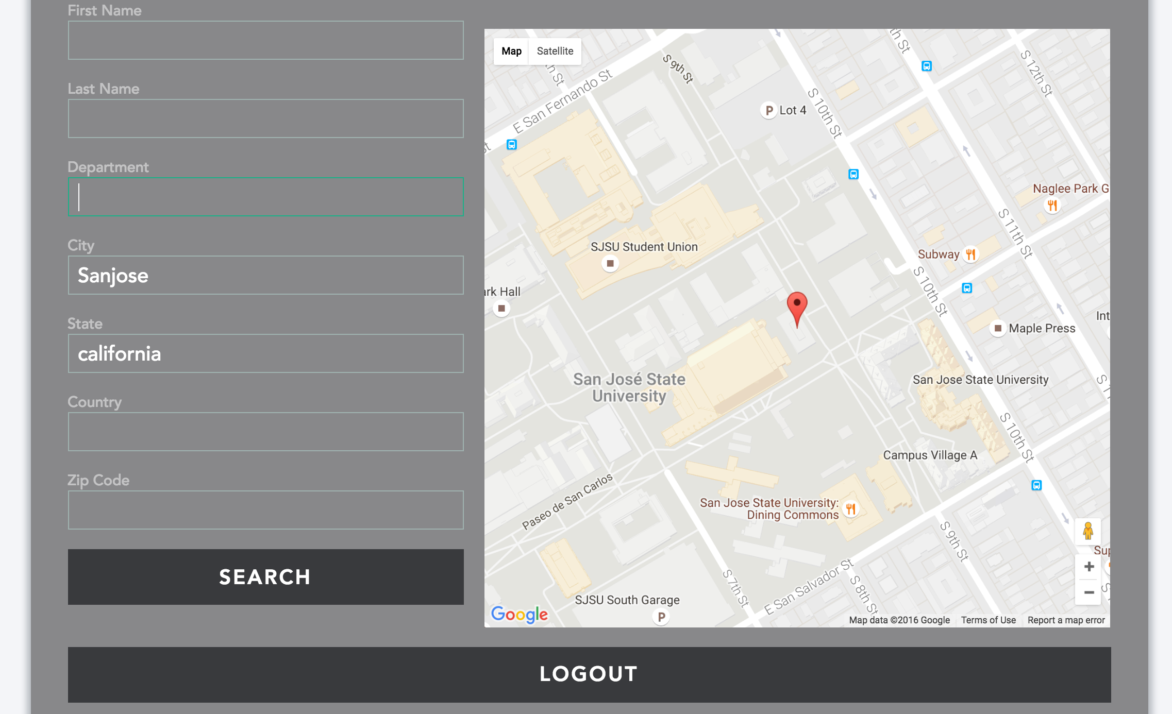
Operational Queries
Search Employee based on department, employee geo- location:
After login, the employee and patient can search the doctors based on Department, First name, Last name, Zip Code, City, State

Slide 15
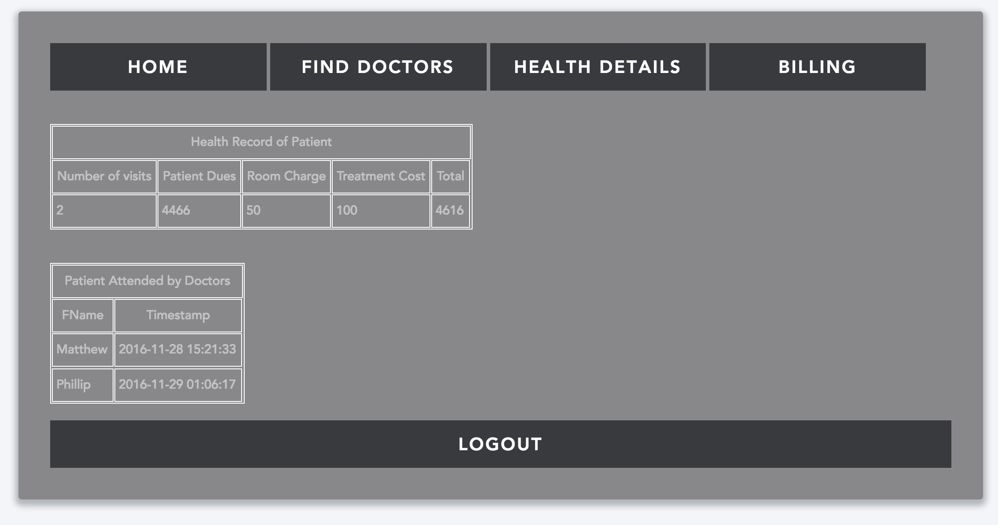
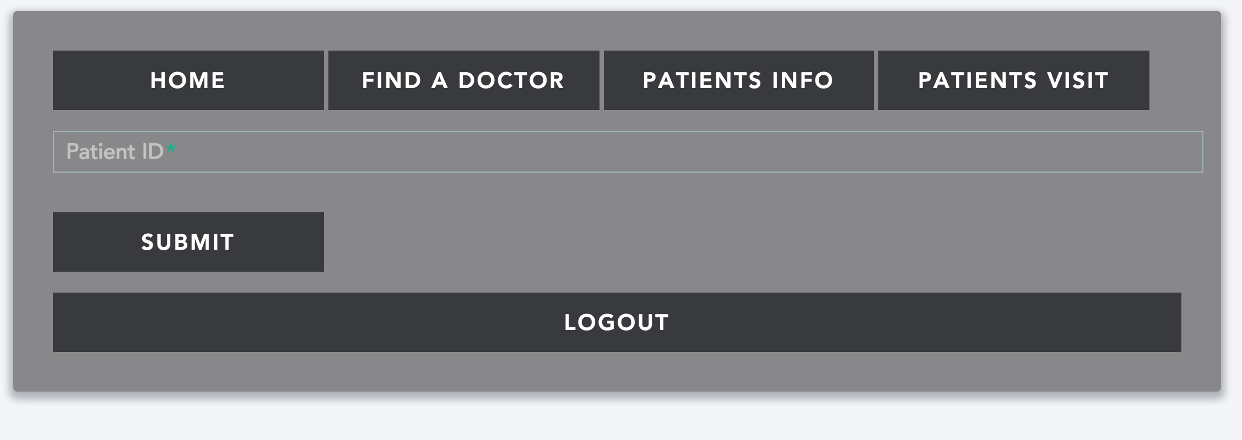
Operational Queries
Update billing information when a doctor visits a patient -
When an employee is signed in, he will enter the patient id whom he attended. On submitting the id, a query will run that will update the billing cost as “dues” in patient table by adding that particular doctor cost to pending dues. This module will also inform about the employee details who attended that patient. The billing module is available after patient login.

Slide 16
Operational Queries
Calculate total bill of a patient based:
Here a join query will run that will give the billing cost of patient based on room charges, treatment charges, visit charges and doctor charges

Slide 17
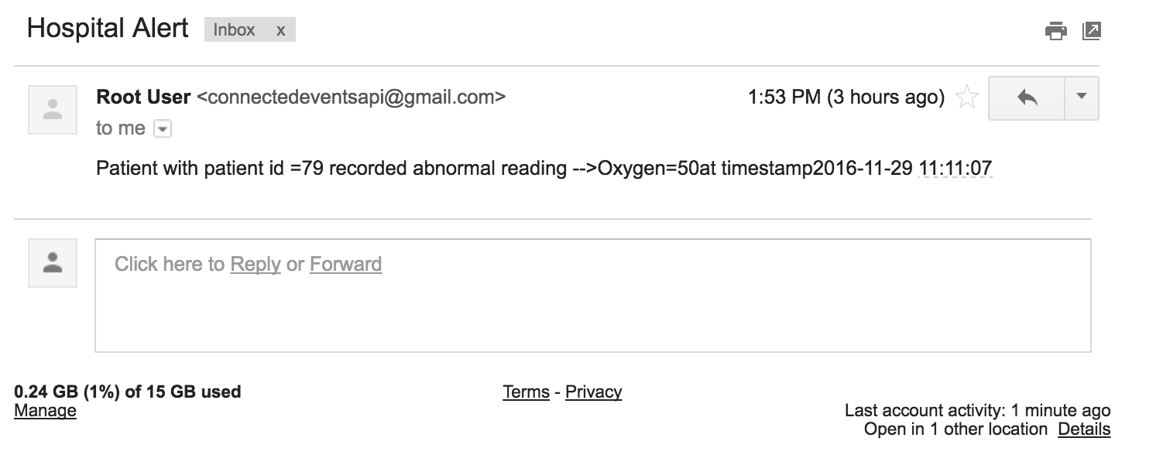
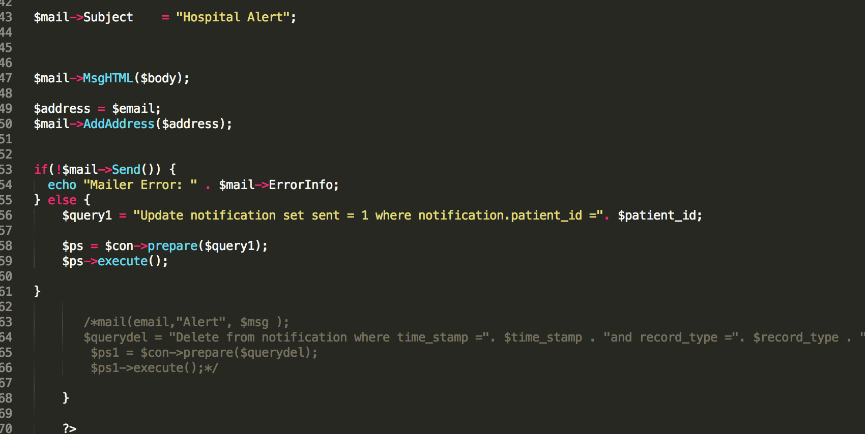
Operational Queries
Alert Mail
Send email alert to main doctor if certain reading is greater than a threshold value.

Slide 18
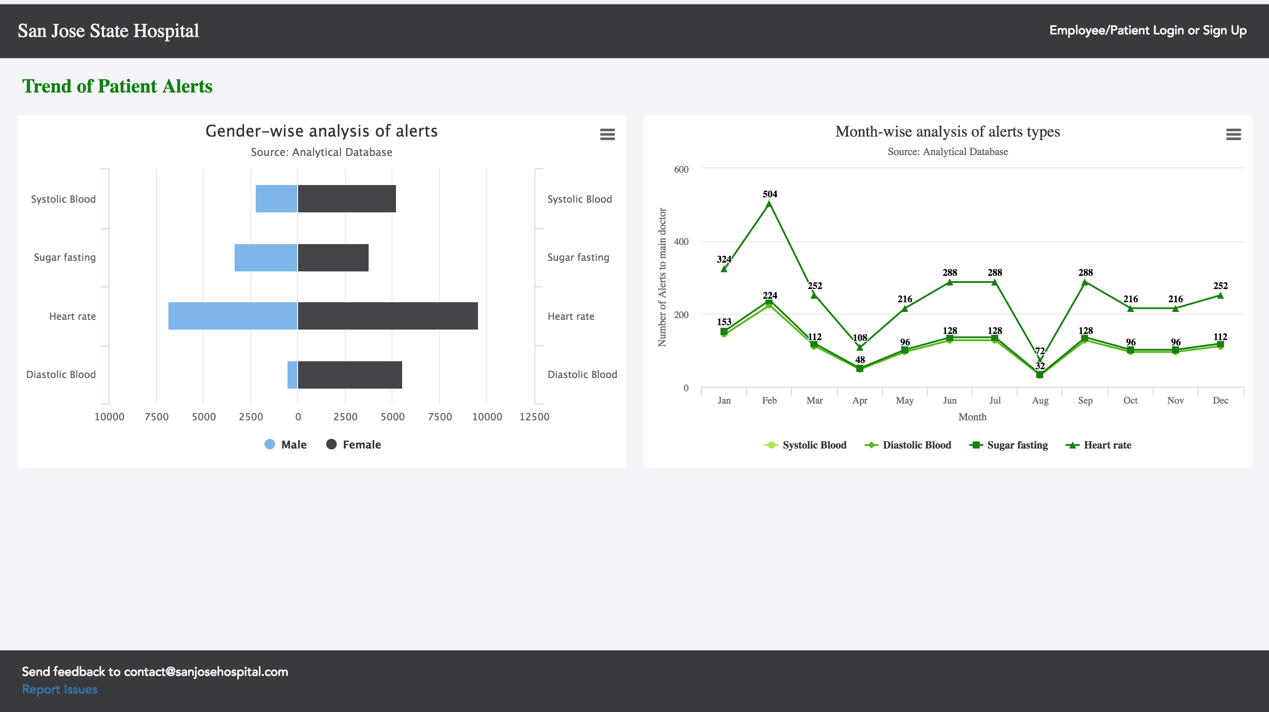
Display all the analytical information in form of graphs and chart

Slide 19
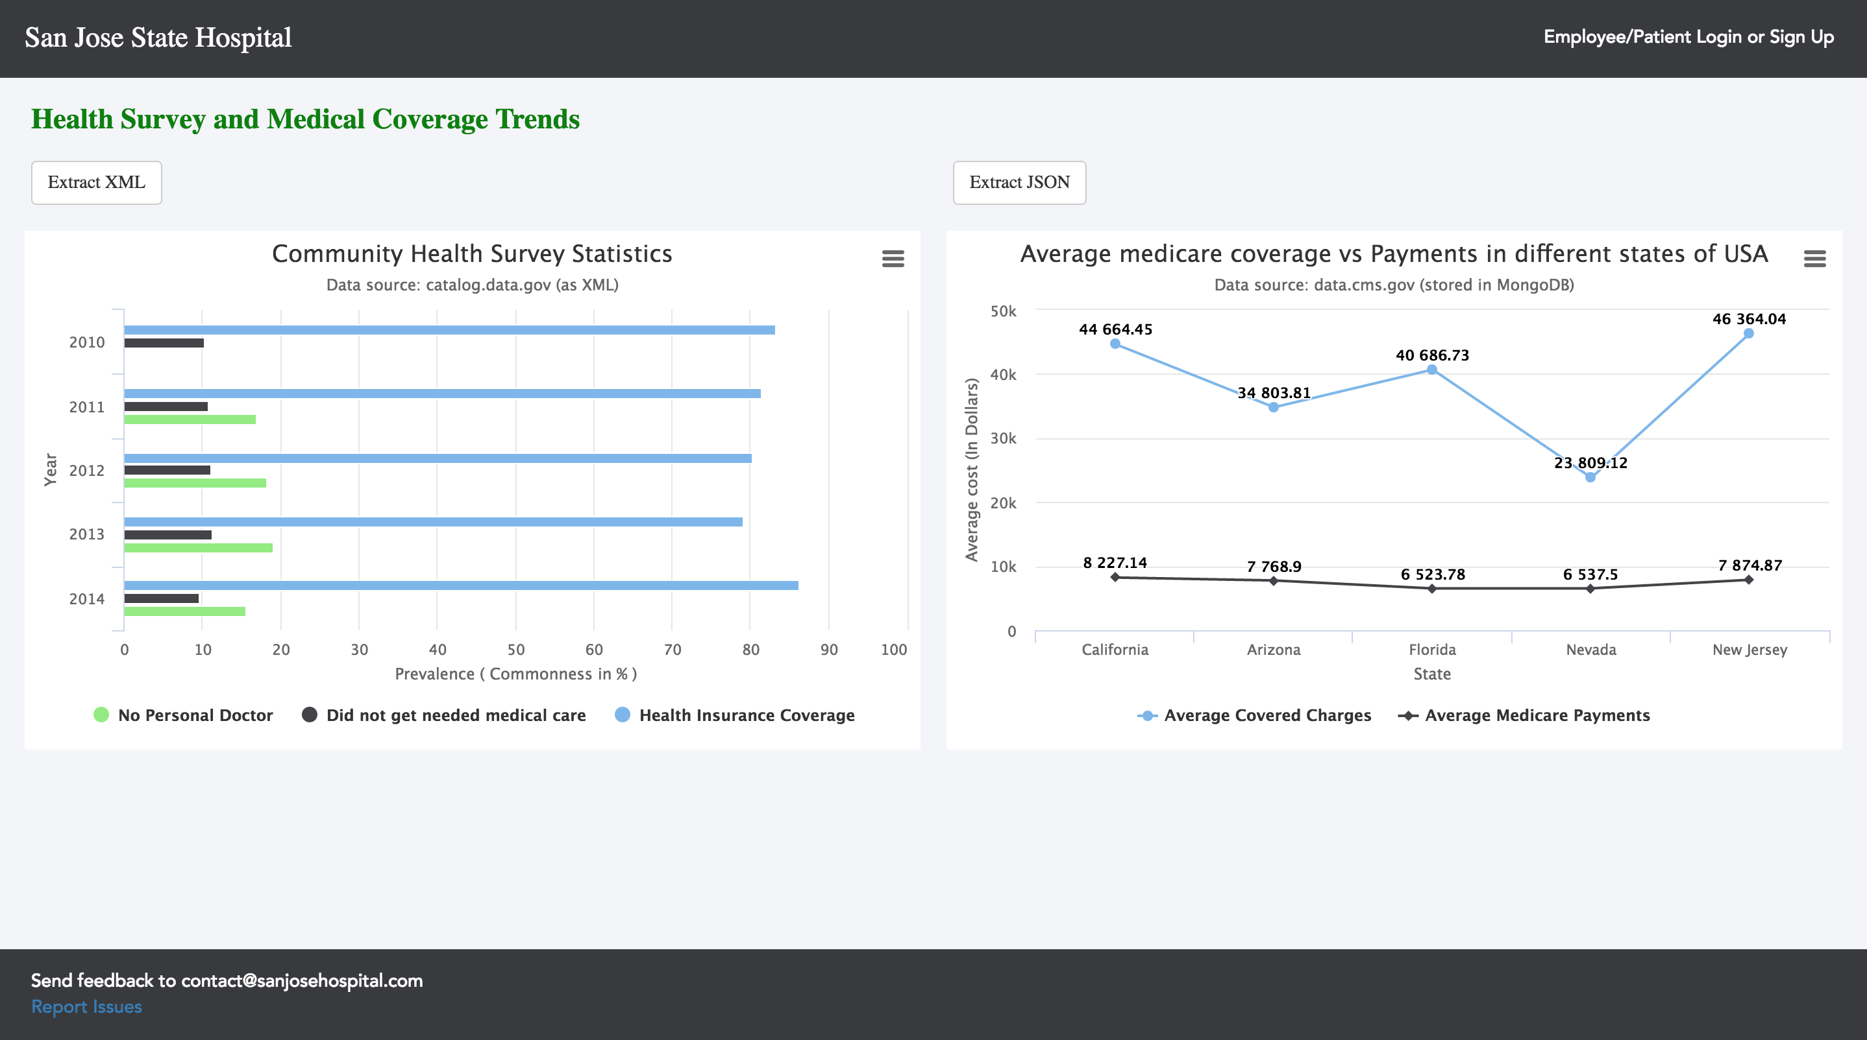

Slide 20
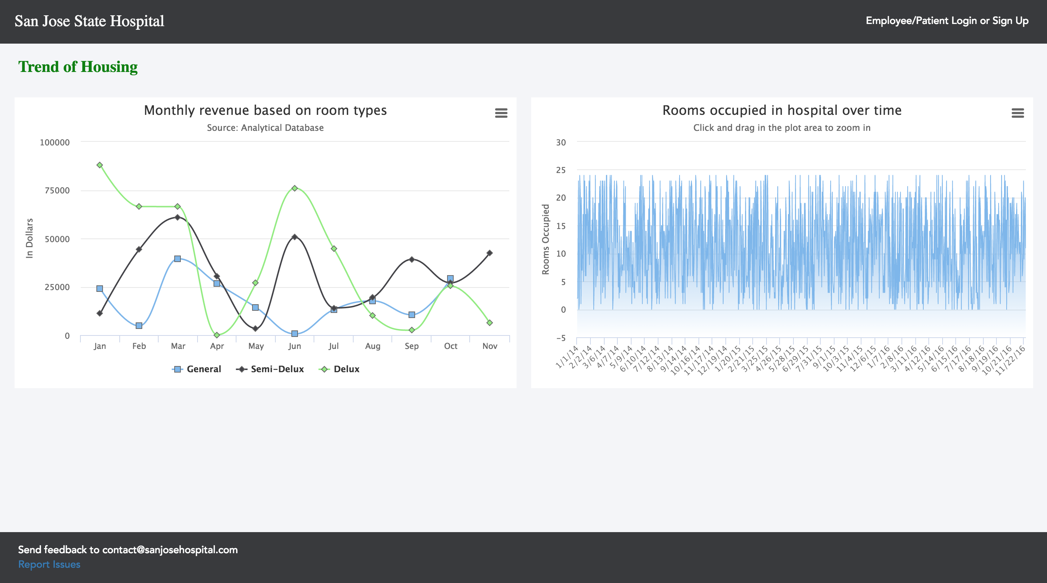

Slide 21
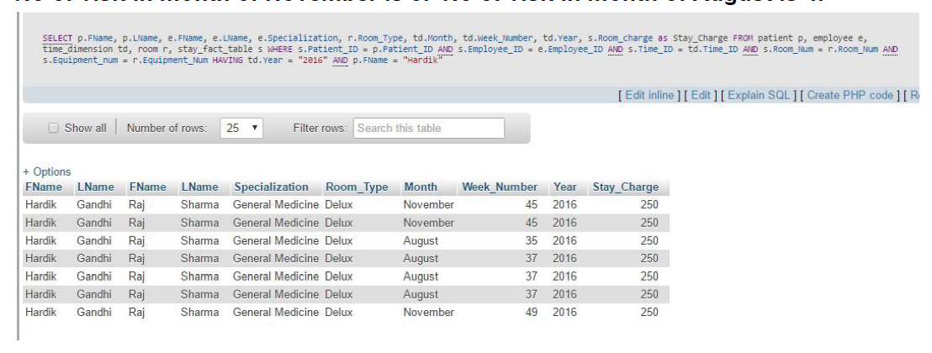
OLAP Queries
Drill Up:
In this query we are drilling up or perform aggregation on the dimension time. Following is the hierarchy structure which is traversed when we are drilling up
Days → Weeks → Months → Year

Slide 22
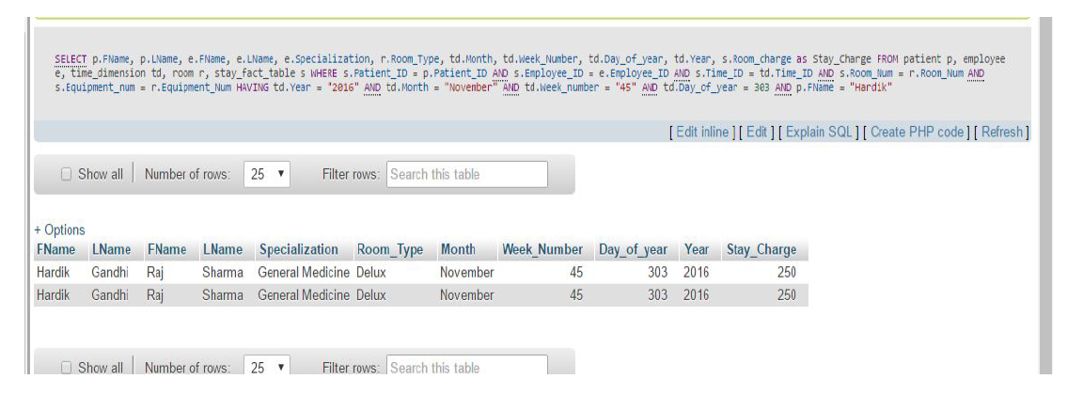
Drill Down:
In this query we are drilling down on the dimension time.
Following is the hierarchy structure which is traversed when we are drilling down
Year → Month → week → day

Slide 23
OLAP Queries
Slice:
Slice performs a selection on one dimension of the data cube. Here we are selecting the dimension Treatment type which has a value equal to "Heart Rate"
Dice:
The dice operation defines a subcube by performing a selection on two or more dimensions. Here dice operation is performed using two dimensions Treatment type and Employee_ID.

Slide 24
Demo and Q&A

